Slide 1
Machine Learning Based Intoxication Detection
By : Rishika Kalra
2021A3PS2651P

Slide 2
Objective
The objective of this project is to develop a non-invasive, camera-based system for detecting alcohol intoxication by analysing thermal images of the face. This system will integrate an infrared camera with a mobile application, allowing for real-time processing of facial thermal images using deep learning models, such as convolutional neural networks (CNNs). The goal is to accurately classify individuals based on their intoxication levels, providing a fast, reliable, and contact-free alternative to traditional methods. Ultimately, the project aims to contribute to road safety by offering a practical solution for identifying intoxicated drivers, reducing the risk of alcohol-related accidents​.

Slide 3
Literature review
Recent advancements focus on developing non-invasive alcohol detection methods using imaging and machine learning to overcome the limitations of traditional tools like breathalyzers and blood tests.
Thermal Imaging with Infrared Cameras Infrared cameras capture facial temperature changes caused by alcohol consumption. This method, using devices like FLIR ONE, is non-invasive and works in various lighting conditions, making it ideal for real-time roadside checks.
Deep Learning for Image Processing Convolutional Neural Networks (CNNs) process thermal images to classify alcohol levels. Models like NasnetMobile and MobileNet have shown high accuracy in detecting intoxication levels, demonstrating CNNs' effectiveness in visual data analysis.

Slide 4
Preprocessing and Augmentation Techniques like Gaussian noise, blur filters, and data augmentation improve model performance by simulating real-world conditions, making models more resilient and generalizable.
Local Difference Patterns (LDP) LDPs analyze pixel variations in specific facial regions, detecting intoxication with 85% accuracy. This simple, robust method is effective for immediate detection without a sober baseline image.
Hybrid Embedded Systems Combining image processing with sensor networks, this approach uses machine learning algorithms, such as k-NN and neural networks, to achieve up to 98% accuracy in detecting intoxicated drivers, enhancing its practical use in vehicles.
Gait Analysis Fine-grained gait classification using Bilinear CNNs converts gait signals into images for intoxication detection, showing superior performance and requiring no additional hardware.

Slide 5
Dataset Overview
This dataset consists of 15 raw video clips featuring non-intoxicated participants, extracted from a larger video file.
Source: Segmented from one larger video.
Participants: All in a non-intoxicated state, serving as a control group.
Format: Raw, unprocessed videos.
Purpose:
Used for machine learning model training to detect intoxication.
Enables feature extraction, such as facial expressions and movements, to aid in developing detection algorithms.

Slide 6
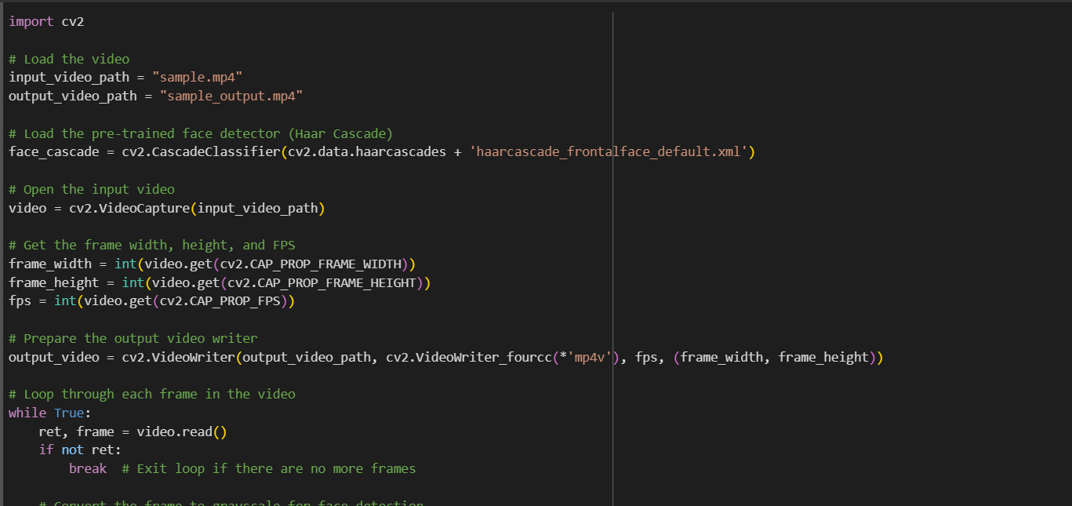
Experiments and Results
Face detection using cascade classifier

Slide 7
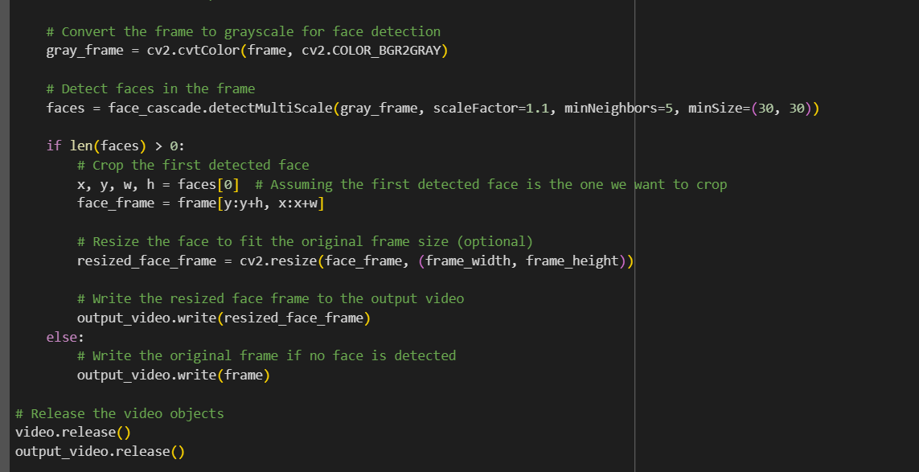

Slide 8
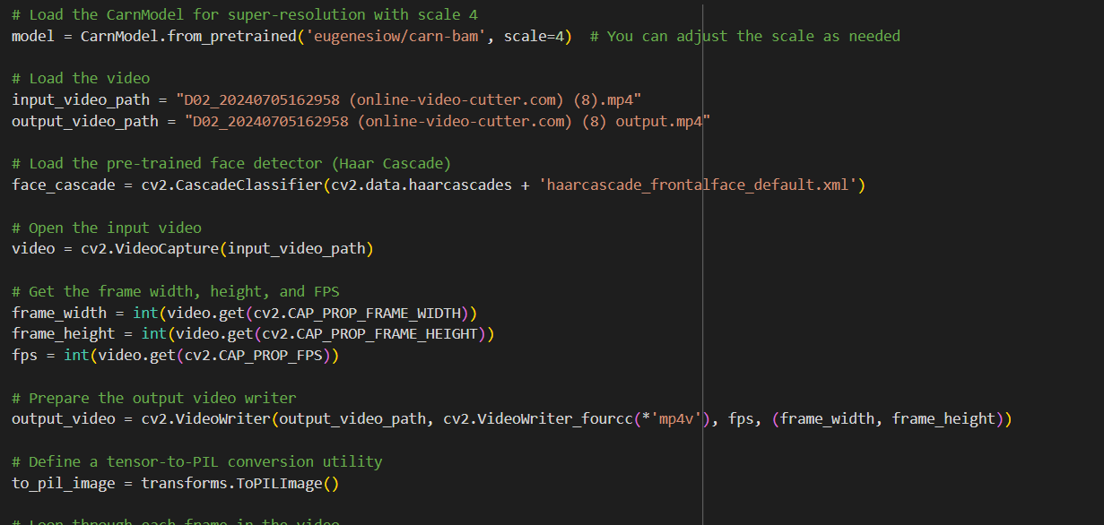
2) Face detection using super resolution model

Slide 9
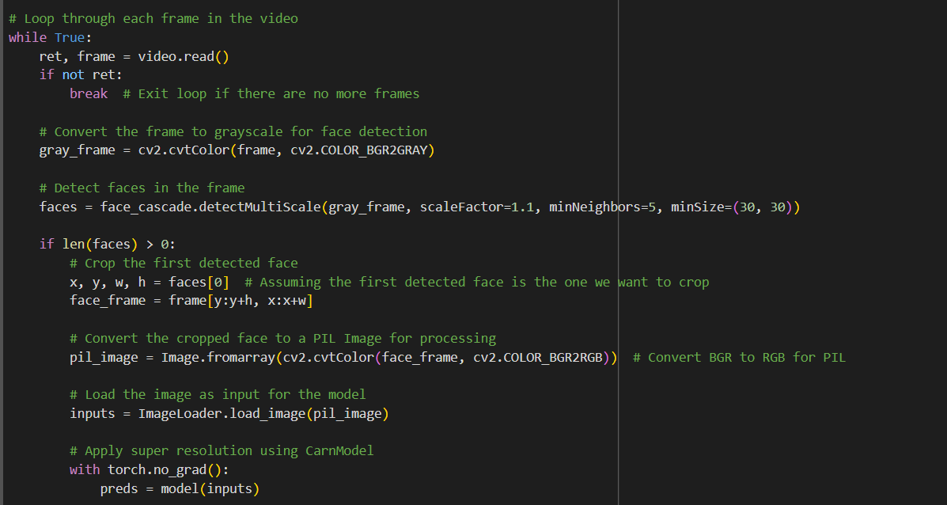

Slide 10
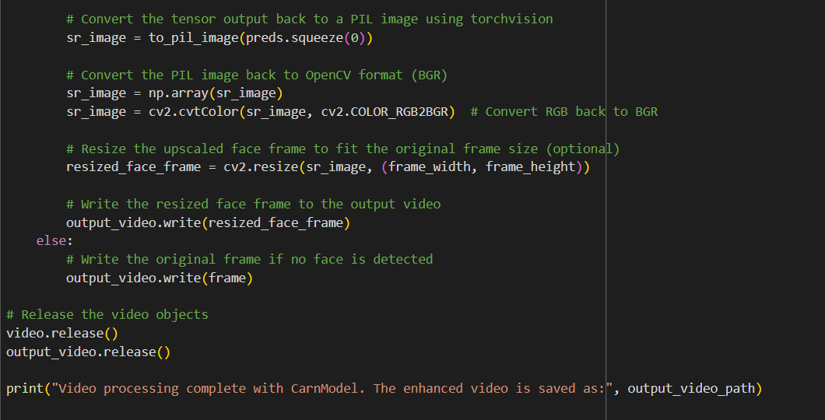

Slide 11
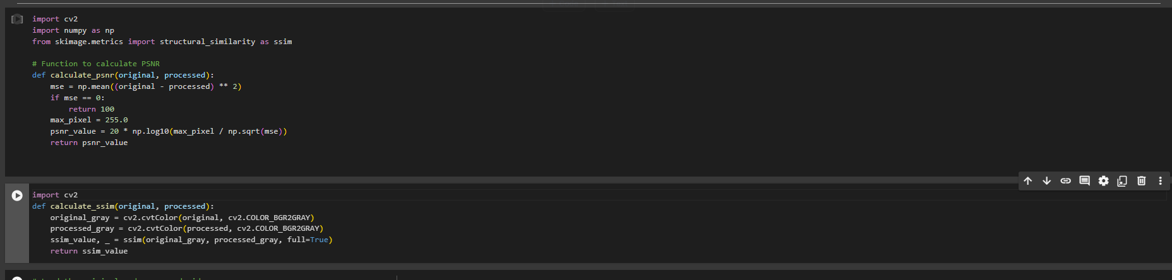
3) Calculating psnr and ssim values

Slide 12
Results
PSNR (Peak Signal-to-Noise Ratio) and SSIM (Structural Similarity Index) are two commonly used metrics for evaluating the quality of images and videos, especially in the context of image processing and compression.
PSNR (Peak Signal-to-Noise Ratio)
Typical Values: For effective super-resolution models, PSNR values usually range from 25 dB to 40 dB.
Interpretation:
Below 20 dB: Generally indicates poor quality, with significant differences from the original image.
20 dB to 25 dB: Acceptable quality, but noticeable artifacts may be present.
25 dB to 30 dB: Fair to good quality, with some visible artifacts but overall decent resemblance to the original image.
30 dB to 35 dB: Good quality, often acceptable for practical applications.
Above 35 dB: Excellent quality, indicating that the super-resolved image is very close to the original image
The PSNR values that we got for the respective videos ranged from 28.75 to the highest being 36.12

Slide 13
SSIM (Structural Similarity Index)
Typical Values: For effective super-resolution models, SSIM values typically range from 0.7 to 1.0.
Interpretation:
Below 0.5: Indicates poor structural similarity; significant loss of details and visual integrity.
0.5 to 0.7: Fair structural quality; some noticeable artifacts and differences from the original.
0.7 to 0.85: Good structural similarity; generally acceptable, with some minor artifacts that may not be easily noticeable.
Above 0.85: Excellent structural similarity; the super-resolved image retains most of the original structure and visual details.
1.0: Perfect structural similarity (rare in practice).
The SSIM values ranged from 0.4095 to 0.885.

Slide 14
Conclusion and Future work
The video processing application successfully enhances facial image quality using super-resolution techniques, with promising PSNR (>30 dB) and SSIM (>0.7) results. These metrics validate the effectiveness of the approach, making it applicable to real-world scenarios like video surveillance and conferencing.
Future Work:
Expand the dataset with thermal images of individuals before and after alcohol consumption.
Further train and fine-tune deep learning models to improve accuracy in distinguishing sober vs. intoxicated states.

Slide 15
Thank you!

